Slide 1

Management
Overview
9861 Broken Land Parkway
Fourth Floor
Columbia, Maryland 21046
800-638-6316
www.mccabe.com
support@mccabe.com
1-800-634-0150

Slide 2
Program Complexity Metrics
Software metrics
Complexity metrics
Complexity metric evaluation
Benefits of complexity measurement

Slide 3
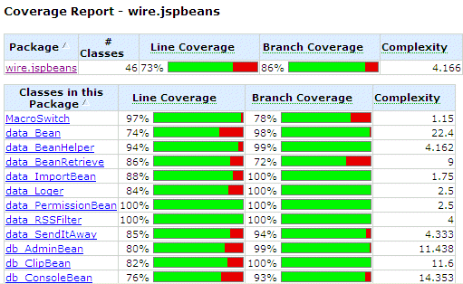
Code Coverage Report

Slide 4
INDEPENDENT PATH TESTING
An independent path is any path through the program that introduces at least one new set of processing statements or a new condition.
In the flow graph, an independent path must
move along at least one edge that has not been traversed before the path is defined.

Slide 5
List the independent paths
1
2
3
8
4
5
6
7
9

Slide 6
INDEPENDENT PATHS
1
2
3
8
4
5
1-9
6
1-2-8-7-1-9
7
1-2-3-4-6-7-1-9
1-2-3-5-6-7-1-9
9

Slide 7
Software Risk Management
Software risk falls into two major categories
  Non-technical risk: how important is the system?
    Usually known early
  Technical risk: how likely is the system to fail?
    Often known too late
Complexity analysis quantifies technical risk
  Helps quantify reliability and maintainability
    This helps with prioritization, resource allocation, contingency planning, etc.
  Guides testing
    Focuses effort to mitigate greatest risks
    Helps deploy testing resources efficiently

Slide 8
Software Metrics Overview
Metrics are quantitative measures
  Operational: cost, failure rate, change effort, …
  Intrinsic: size, complexity, …
Most operational metrics are known too late
  Cost, failure rate are only known after deployment
  So, they aren’t suitable for risk management
Complexity metrics are available immediately
  Complexity is calculated from source code
Complexity predicts operational metrics
  Complexity correlates with defects, maintenance costs, ...

Slide 9
Complexity Metric Evaluation
Good complexity metrics have three properties
  Descriptive: objectively measure something
  Predictive: correlate with something interesting
  Prescriptive: guide risk reduction
Consider lines of code
  Descriptive: yes, measures software size
  Predictive, Prescriptive: no
Consider cyclomatic complexity
  Descriptive: yes, measures decision logic
  Predictive: yes, predicts errors and maintenance
  Prescriptive: yes, guides testing and improvement

Slide 10
Benefits of Complexity Measurement
Complexity metrics are available from code
  They can even be estimated from a design
They provide continuous feedback
  They can identify high-risk software as soon as it is written or changed
They pinpoint areas of potential instability
  They can focus resources for reviews, testing, and code improvement
They help predict eventual operational metrics
  Systems with similar complexity metric profiles tend to have similar test effort, cost, error frequency, ...

Slide 11
McCabe Concepts
Definition: In C and C++, a module is a function or subroutine with a single entry point and a single exit point. A module is represented by a rectangular box on the Battlemap.
main
Difficult to maintainable module
function a
function c
Difficult to test module
Library module
printf
function d
Well-designed, testable module

Slide 12
Analyzing a Module
For each module, an annotated source listing and flowgraph is generated.
Flowgraph - an architectural diagram of a software module’s logic.
Stmt Code
Number
Battlemap
main Flowgraph
1 main()
2 {
3 printf(“example”);
4 if (y > 10)
5 b();
6 else
7 c();
8 printf(“end”);
9 }
main
1-3
node:statement or block
of sequential statements
4
condition
b
c
printf
5
7
end of condition
edge: flow of control
between nodes
8-9

Slide 13
Flowgraph Notation (C)
if (i) ;
if (i) ; else ;
if (i && j) ;
if (i || j) ;
do ; while (i);
while (i) ;
switch(i) { case 0: break; ... }

Slide 14
Flowgraph Notation (C)
if (i) ;
if (i) ; else ;
if (i && j) ;
if (i || j) ;
do ; while (i);
while (i) ;
switch(i) { case 0: break; ... }

Slide 15
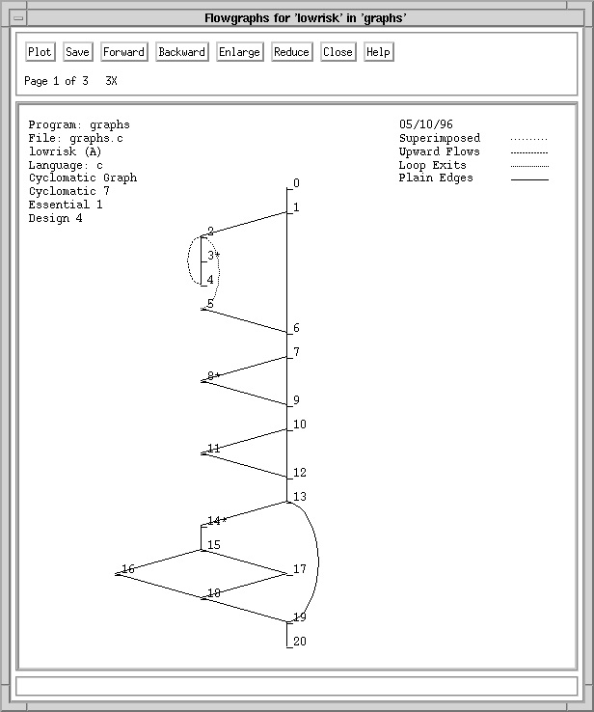
Low Complexity Software
Reliable
  Simple logic
    Low cyclomatic complexity
  Not error-prone
  Easy to test
Maintainable
  Good structure
    Low essential complexity
  Easy to understand
  Easy to modify

Slide 16
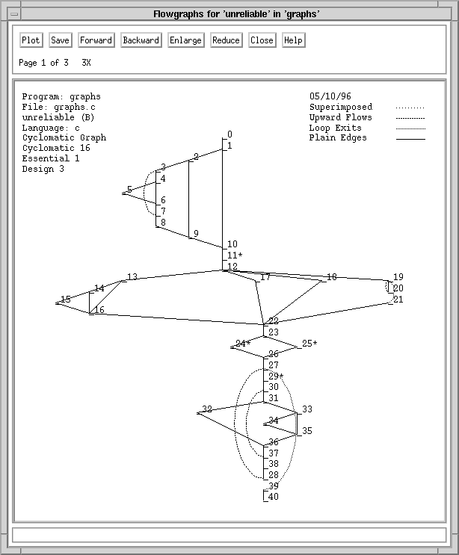
Moderately Complex Software
Unreliable
  Complicated logic
    High cyclomatic complexity
  Error-prone
  Hard to test
Maintainable
  Can be understood
  Can be modified
  Can be improved

Slide 17
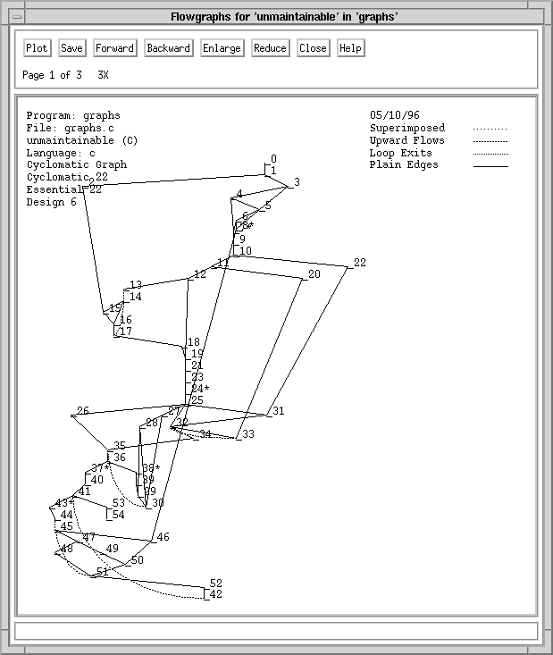
Highly Complex Software
Unreliable
  Error prone
  Very hard to test
Unmaintainable
  Poor structure
    High essential complexity
  Hard to understand
  Hard to modify
  Hard to improve

Slide 18
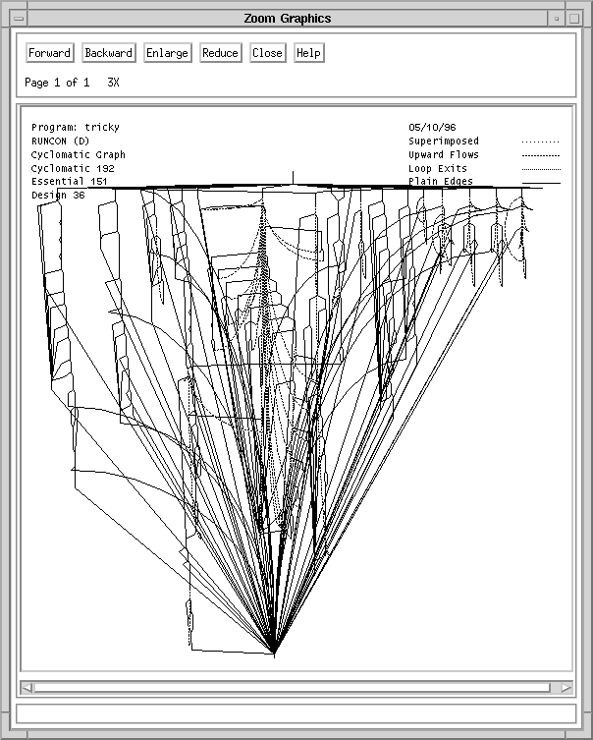
Would you buy a used car from this software?
Problem: There are size
and complexity boundaries
beyond which software
becomes hopeless
  Too error-prone to use
  Too complex to fix
  Too large to redevelop
Solution: Control complexity
during development and
maintenance
  Stay away from the boundary

Slide 19
Important Complexity Measures
Cyclomatic complexity: v(G)
  Amount of decision logic
Essential complexity: ev(G)
  Amount of poorly-structured logic
Module design complexity: iv(G)
  Amount of logic involved with subroutine calls

Slide 20
Cyclomatic Complexity
The most famous complexity metric
Measures amount of decision logic
Identifies unreliable software, hard-to-test software
Related test thoroughness metric, actual complexity, measures testing progress

Slide 21
Cyclomatic Complexity
Cyclomatic complexity, v - A measure of the decision logic of a software module.
  Applies to decision logic embedded within written code.
  Is derived from predicates in decision logic.
  Is calculated for each module in the Battlemap.
  Grows from 1 to high, finite number based on the amount of decision logic.
  Is correlated to software quality and testing quantity; units with higher v, v>10, are less reliable and require high levels of testing.
Notes:
Initiate Exercise I. After each concept, click on the Battlemap and illustrate the concept.

Slide 22
Cyclomatic Complexity
1
1
2
5
2
π=2
4
edges and node method
e = 24, n = 15
v = 24 -15 +2
v = 11
R1
3
R2
3
6
4
7
5
π=1
π=1
R3
9
R4
8
6
10
R5
11
7
predicate method
v = π + 1
v = 11
π=1
12
8
R11
13
9
17
14
π=2
16
region method
regions = 11
Beware of crossing lines
R6
15
R7
10
18
11
19
12
π=1
R8
π=1
R9
21
20
13
22
R10
23
23
14
π=1
24
15

Slide 23
Program Complexity
McCabe’s Cyclomatic complexity is equal to the maximum number of “linearly independent” paths throughout the program.
Those are called Basis Paths and any other path throughout the program can be expressed as a combination of some of these paths.
The simplest way to compute cyclomatic complexity is the number of regions in the flow graph plus one.

Slide 24
How Many Paths Through the Program?
credit rating >= 4?
IF credit rating > = 4
THEN
approve
ELSE
IF (income >= 100,000) AND
(number of children < 3)
THEN
approve
ELSE
disapprove
N
Y
3
Approve
1
4
income >=100,000?
2
Y
N
Y
children < 3?
N
Disapprove

Slide 25
Loop Example
credit rating >= 4?
Y
N
1
Approve
income >=100,000?
5
Y
Y
2
N
3
4
N
children < 3?
Disapprove
More?
Now how many paths?

Slide 26
Cyclomatic complexity of programming constructs
1. if E then
A
else
B
2. C
1. loop
A
2. exit when E
B
3. end loop
4. C
1. case E of
2. a: A
3. b: B
…
k. k-1: N
l. end case
m. L
1. A
B
C
…
2. Z

Slide 27
Cyclomatic complexity of programming constructs
1. if E then
A
else
B
2. C
2
1. loop
A
2. exit when E
B
3. end loop
4. C
1
2
2
M = 2
3
1. case E of
2. a: A
3. b: B
…
k. k-1: N
l. end case
m. L
1
M = 2
4
...
K
1. A
B
C
…
2. Z
2
3
1
l
2
m
M = (2(k-1)+1)-(k+2)+2=K-1
M = 1

Slide 28
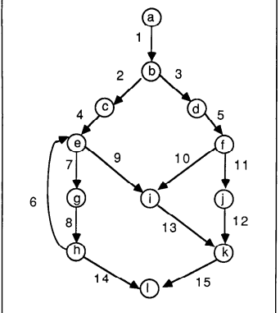
Cyclomatic complexity and
independent paths ?

Slide 29
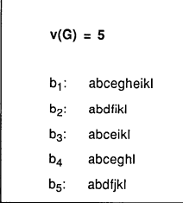

Slide 30
Draw CFG and Calculate Cyclomatic Complexity
public static void sort(int x []) {
for (int i=0; i < x.length-1; i++) {
for (int j=i+1; j < x.length; j++) {
if (x[i] > x[j]) {
int save=x[i];
x[i]=x[j]; x[j]=save
}
}
}
}

Slide 31
Example program
1
2
public static void sort(int x []) {
for (int i=0; i < x.length-1; i++) {
for (int j=i+1; j < x.length; j++) {
if (x[i] > x[j]) {
int save=x[i];
x[i]=x[j]; x[j]=save
}
}
}
}
3
4
5
6
11
7
8
9
10

Slide 32
Cyclomatic complexity
1
2
e = number of edges (13)
n = number of nodes (11)
p = number of connected components (1)
CV = 4
3
4
5
6
11
7
8
9
10

Slide 33
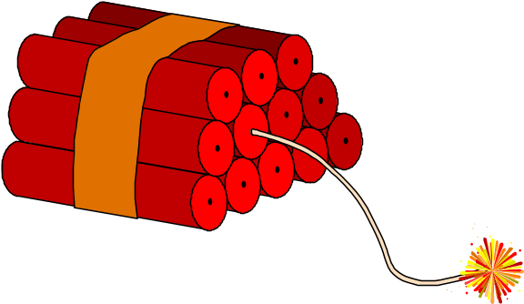
Vital Signs and High v’s
Higher risk of failures
Difficult to understand
Unpredictable expected results
Complicated test environments including more
test drivers
Knowledge transfer constraints to new staff
Risks of
increasing
v
20
15
10
5
TIME

Slide 34
Essential Complexity
Measures amount of poorly-structured logic
Remove all well-structured logic, take cyclomatic complexity of what’s left
Identifies unmaintainable software
Pathological complexity metric is similar
  Identifies extremely unmaintainable software

Slide 35
Essential Complexity
Essential complexity, ev - A measure of “structuredness” of decision logic of a software module.
  Applies to decision logic embedded within written code.
  Is calculated for each module in the Battlemap.
  Grows from 1 to v based on the amount of “unstructured” decision logic.
  Is associated with the ability to modularize complex modules.
  If ev increases, then the coder is not using structured programming constructs.
Notes:
Initiate Exercise I. After each concept, click on the Battlemap and illustrate the concept.

Slide 36

Essential Complexity - Unstructured Logic
Branching out of a loop
Branching in to a loop
Branching into a decision
Branching out of a decision

Slide 37
Essential Complexity - Flowgraph Reduction
Essential complexity, ev, is calculated by reducing the module flowgraph. Reduction is completed by removing decisions that conform to single-entry, single-exit constructs.
Cyclomatic
Complexity = 4
Essential
Complexity = 1

Slide 38
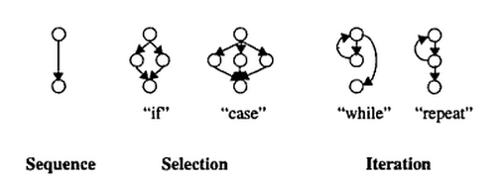
Structured Programming Primitives

Slide 39
Essential Complexity
Flowgraph and reduced flowgraph after structured constructs have been removed, revealing decisions that are unstructured.

Slide 40
Essential Complexity
Flowgraph and reduced flowgraph after structured constructs have been removed, revealing decisions that are unstructured.
v = 5
Reduced flowgraph
v = 3
Therefore ev of the original flowgraph = 3
Superimposed
essential flowgraph

Slide 41
Essential Complexity
Essential complexity helps detect unstructured code.
v = 10
ev = 1
Good designs
v = 11
ev = 10
Can quickly
deteriorate!

Slide 42
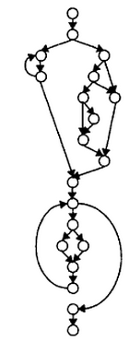

Slide 43
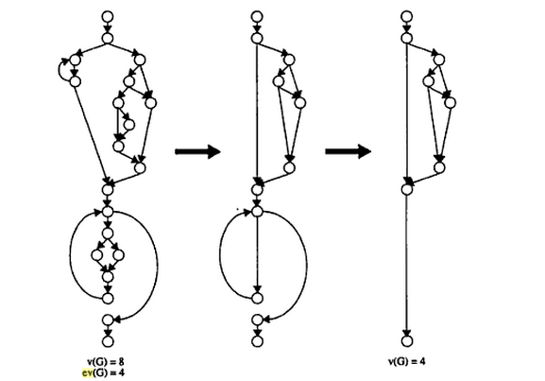

Slide 44

Vital Signs and High ev’s
Intricate logic
Conflicting decisions
Unrealizable test paths
Constraints for architectural improvement
Difficult knowledge transfer to new staff
Risks of
increasing
ev
10
6
3
1
TIME

Slide 45

How to Manage and Reduce v and ev
Decreasing
and managing
v and ev
20
15
Emphasis on design architecture
and methodology
Development and coding standards
QA procedures and reviews
Peer evaluations
Automated tools
Application portfolio management
Modularization
10
1
TIME

Slide 46

Module Design Complexity
How Much Supervising Is Done?

Slide 47
Module design complexity
Measures amount of decision logic involved with subroutine calls
Identifies “managerial” modules
Indicates design reliability, integration testability
Related test thoroughness metric, tested design complexity, measures integration testing progress

Slide 48
Module Design Complexity
Module design complexity, iv - A measure of the decision logic that controls calls to subroutines.
  Applies to decision logic embedded within written code.
  Is derived from predicates in decision logic associated with calls.
  Is calculated for each module in the Battlemap.
  Grows from 1 to v based on the complexity of calling subroutines.
  Is related to the degree of "integratedness" between a calling module and its called modules.
Notes:
Initiate Exercise I. After each concept, click on the Battlemap and illustrate the concept.

Slide 49
Module Design Complexity
Module design complexity, iv, is calculated by reducing the module flowgraph. Reduction is completed by removing decisions and nodes that do not impact the calling control over a module’s immediate subordinates.

Slide 50
Module Design Complexity
Example:
main
iv = 3
main()
{
if (a == b) progd();
if (m == n) proge();
switch(expression)
{
case value_1:
statement1;
break;
case value_2:
statement2;
break;
case value_3:
statement3;
}
}
progd
proge
main
Reduced Flowgraph
v = 5
v = 3
progd()
progd()
proge()
proge()
do not impact calls
Therefore,
iv of the original flowgraph = 3

Slide 51
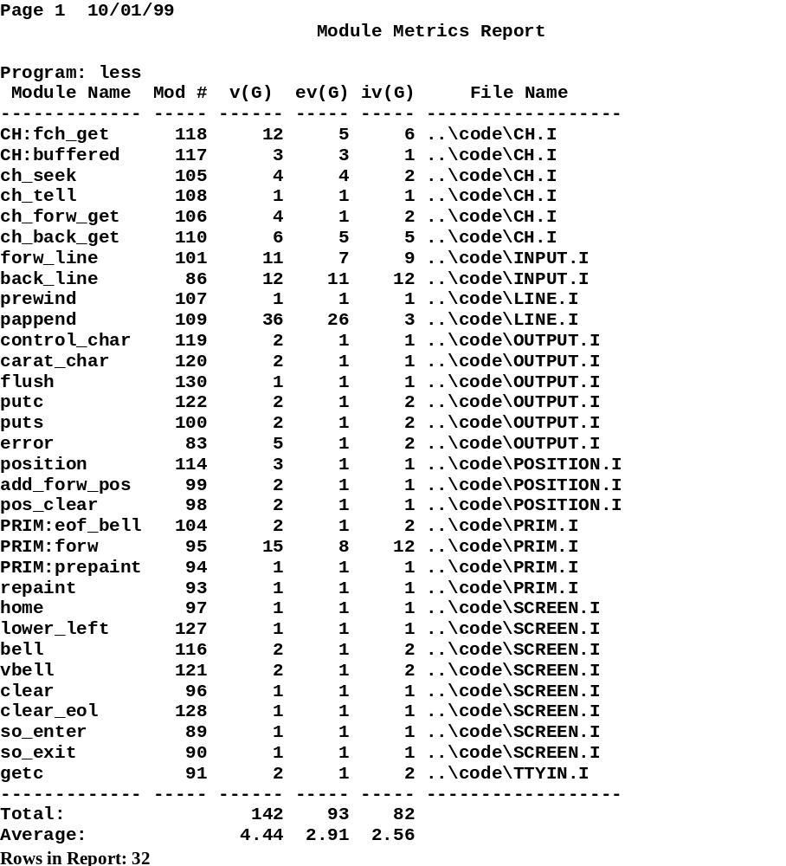
Module Metrics Report
v, number of unit test paths for a module
iv, number of integration tests for a module
Total number of test paths for all modules
Average number of test
paths for each module

